Slide 1
IBM HR Analytics
for
Employee Attrition Prediction
Presented by -
Faymin Chen

Slide 2

Introduction
Attrition is a major problem for all businesses regardless of location, size, and industry sector. A well-managed human resources department is critical to any organization. Companies spend a lot of time and money to nurture their most valuable asset: their employees. When employees leave, companies face huge losses. High turnover means high cost. Hence, it is important to predict turnover rates. The Human Resources Department would greatly benefit from the ability of data scientists to predict employee attrition risk and identify the underlying factors contributing to it, such as inadequate compensation, job dissatisfaction, and commuting distance. This insight will enable them to implement targeted support measures aimed at enhancing employee retention and safeguarding our valuable workforce. In this report, we summarize the findings and insights gained from analyzing the IBM HR Analytics Employee Attrition & Performance dataset.

Slide 3
OBJECTIVE
Employee attrition is the rate at which employees leave a company. The goal of this analysis is to create a model that can determine the most dominant contributing factors affecting attrition. Through this kind of analysis, we can understand how many employees are likely to leave, while also determining which employees are at the highest risk and for what reasons.

Slide 4
METHODOLOGY
Load the Dataset: The IBM HR Analytics Attrition Dataset is loaded using the pd.read_csv() function. The head() and info() methods are used to display the first few rows and get information about the dataset, respectively.
Knowing the Dataset: Basic Information about the dataset is generated; numerical and categorical attributes are enlisted.
Data Cleaning: no duplicate values found. Drop unnecessary uniform columns: EmployeeCount, EmployeeNumber, StandardHours, and Over18
Data Visualization: Seaborn library is used to visualize the data.
Data Preprocessing: The target variable 'Attrition' is mapped to binary values (1 for 'Yes' and 0 for 'No'). Selected features are extracted from the dataset and one-hot encoded using the get_dummies() function.
- Splitting the Dataset: The dataset is split into training and testing sets using the train_test_split() method from scikit-learn.
Implementing Machine Learning Algorithms: Logistic Regression, Gradient Boostin, and Random Forest classifiers are initialized and trained using the training data.
Model Evaluation: AUC ROC score and confusion matrix (precision, recall, F1 score) are computed to evaluate the performance of each algorithm on the testing data.
Results: The results, including the AUC ROC score and confusion matrix, are printed for each algorithm.
Model Performance Comparison:

Slide 5
DATASET
This is a hypothetical dataset created by IBM data scientists. The dataset has 1470 observations and 35 features that contains numeric and categorical data types describing each employee’s background and characteristics, and labeled with whether they are still in the company or whether they have left to work somewhere else.
01] Age
02] Attrition
03] BusinessTravel
04] DailyRate
05] Department
06] DistanceFromHome
07] Education
08] EducationField
09] EmployeeCount
10] EmployeeNumber
11] EnvironmentSatisfaction
12] Gender
13] HourlyRate
14] JobInvolvement
15] JobLevel
16] JobRole
17] JobSatisfaction
18] MaritalStatus
19] MonthlyIncome
20] MonthlyRate
21] NumCompaniesWorked
22] Over18
23] OverTime
24] PercentSalaryHike
25] PerformanceRating
26] RelationshipSatisfaction
27] StandardHours
28] StockOptionLevel
29] TotalWorkingYears
30] TrainingTimesLastYear
31] WorkLifeBalance
32] YearsAtCompany
33] YearsInCurrentRole
34] YearsSinceLastPromotion
35] YearsWithCurrManager

Slide 6
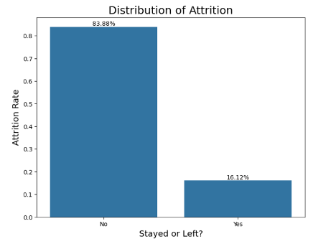
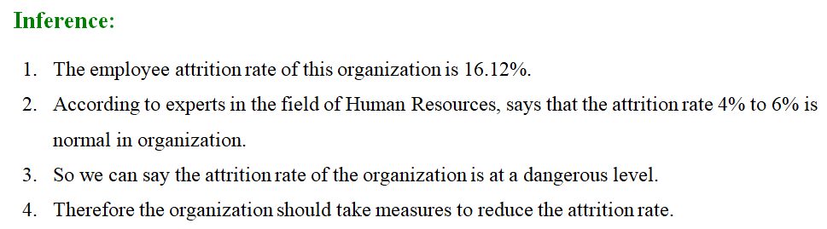
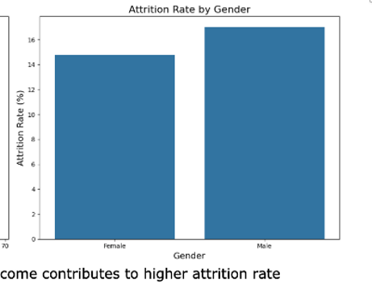
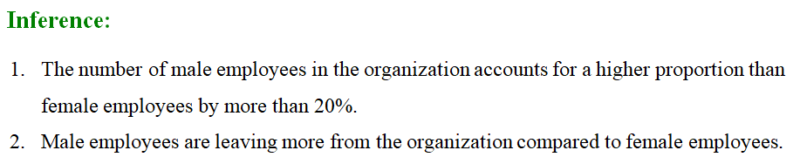

Slide 7
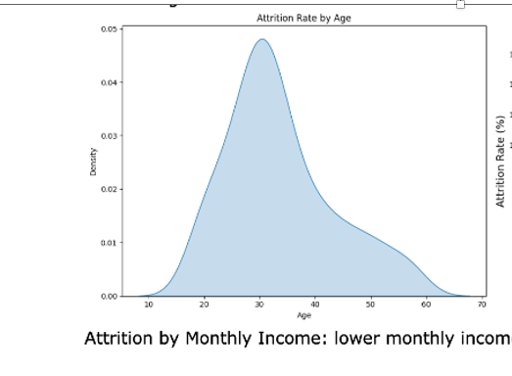
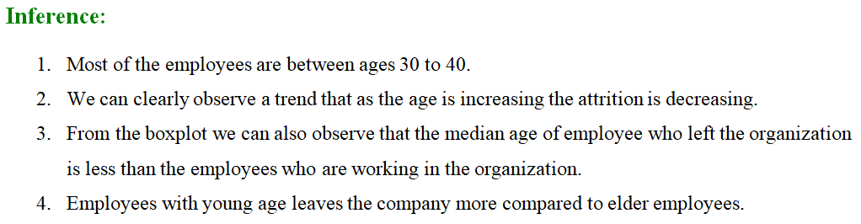
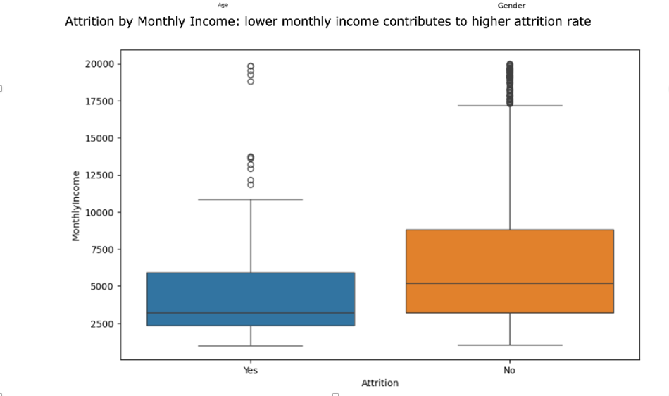
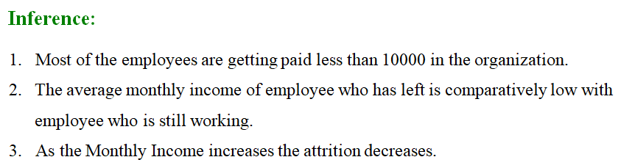

Slide 8
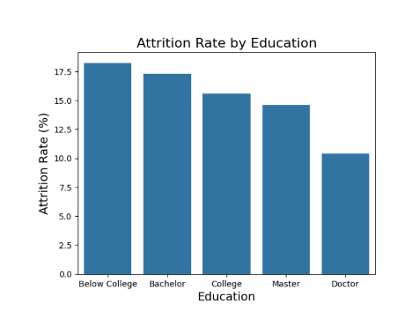
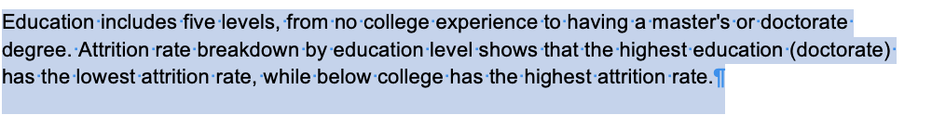
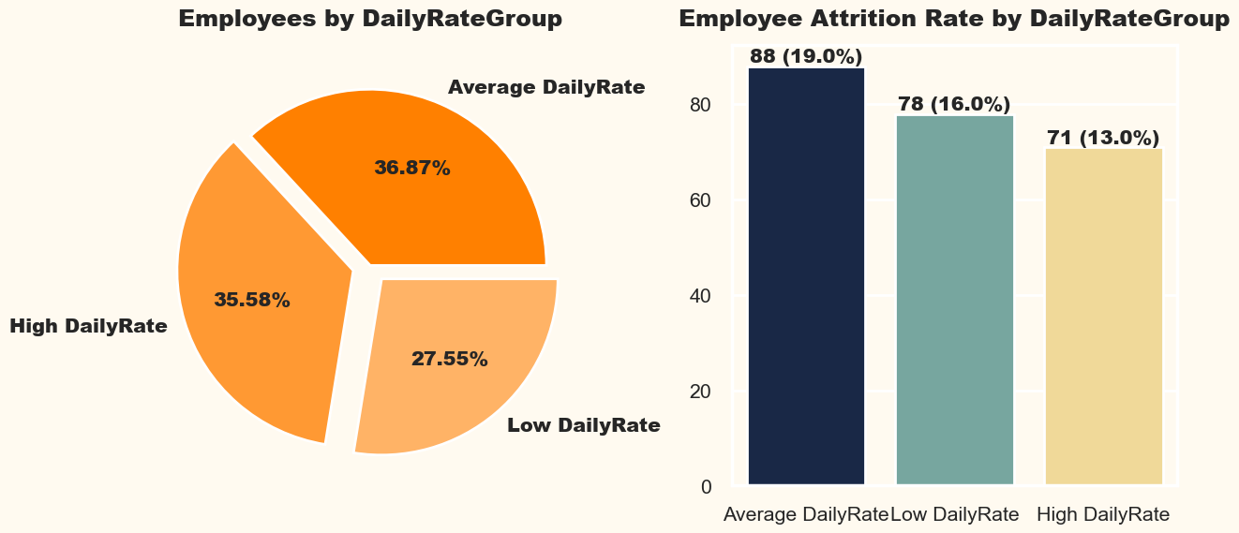
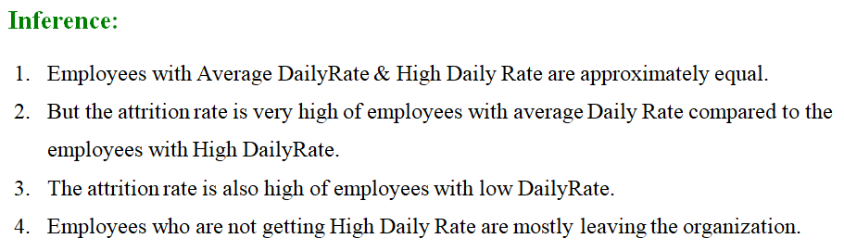

Slide 9
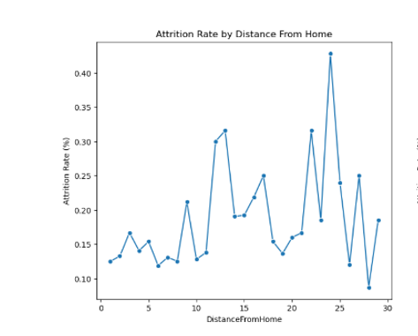
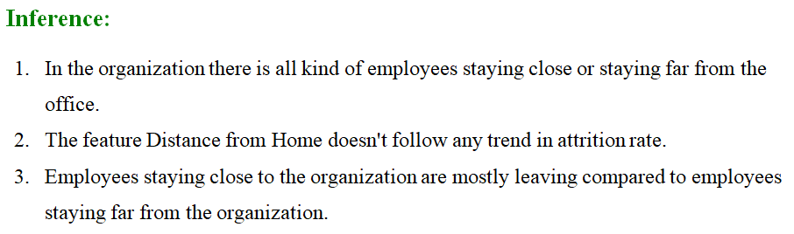
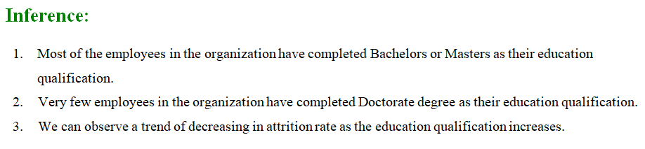

Slide 10
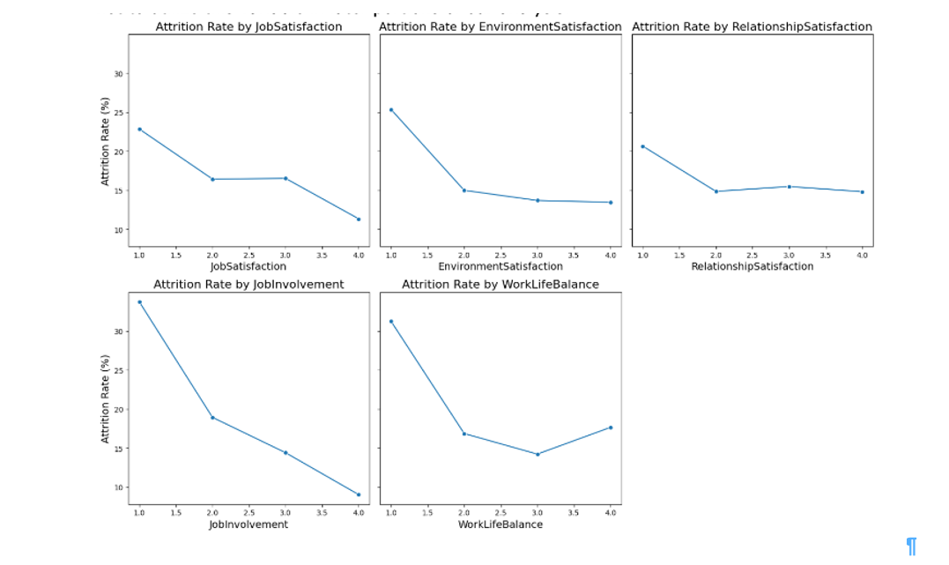
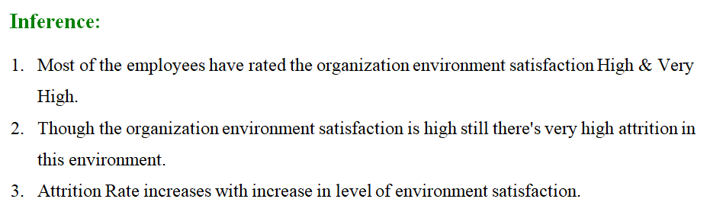
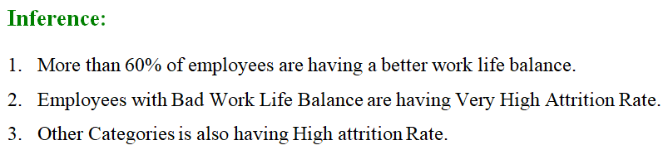
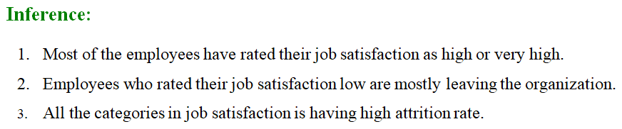
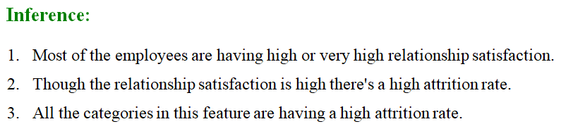

Slide 11
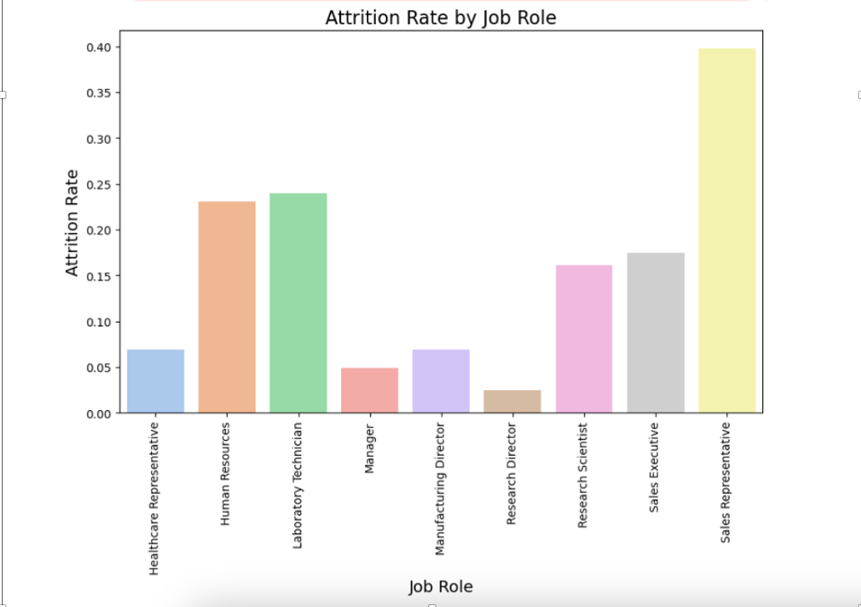
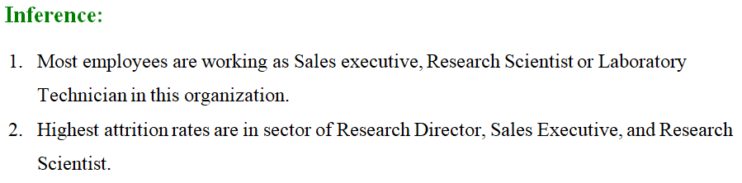
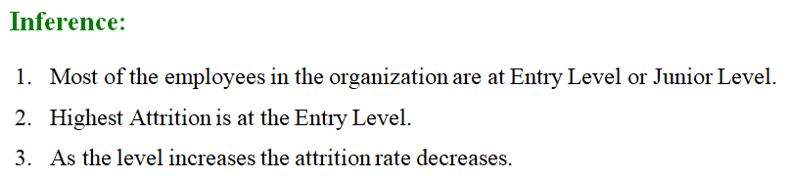

Slide 12
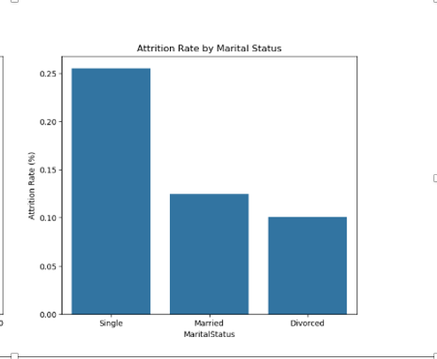
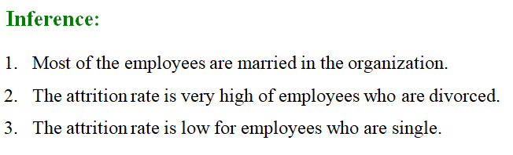
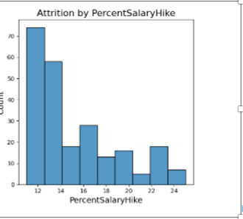
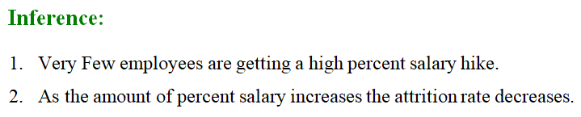

Slide 13
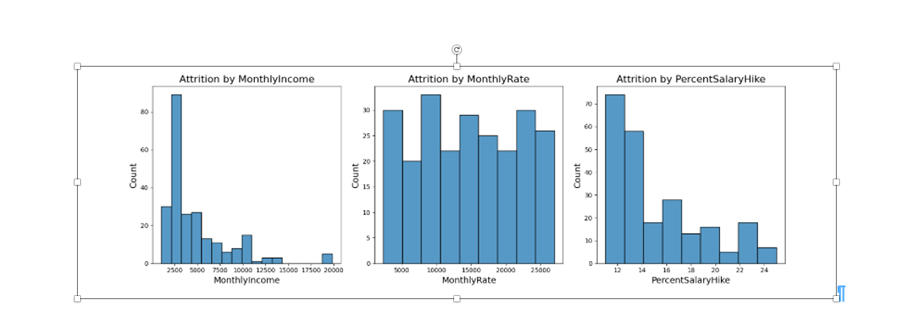
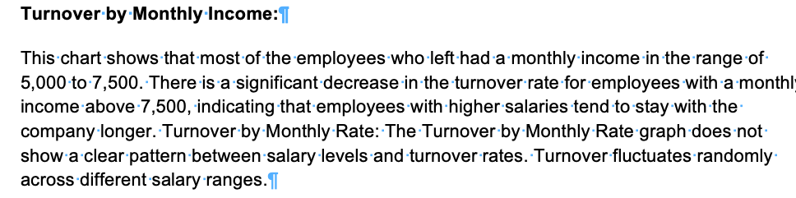
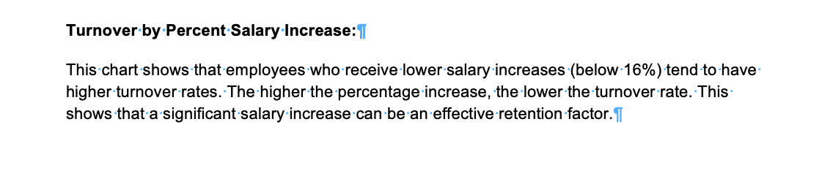

Slide 14
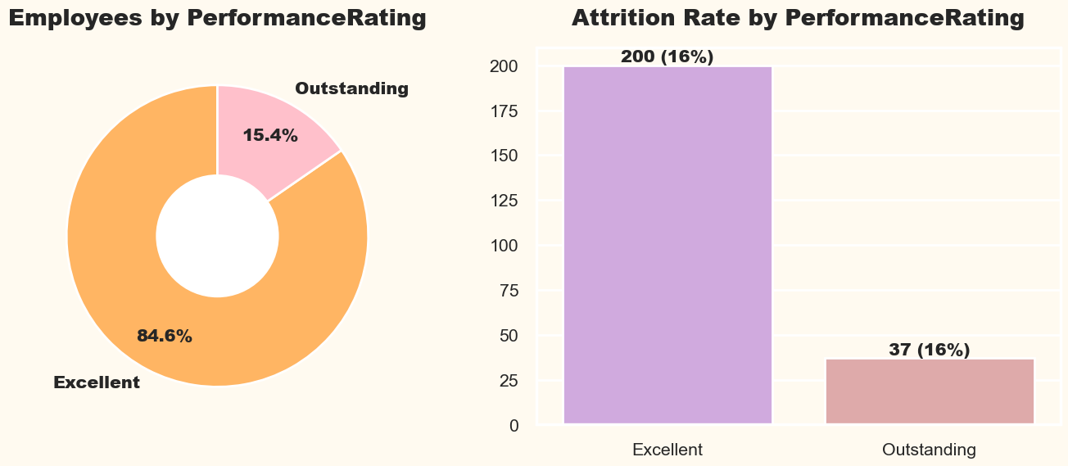
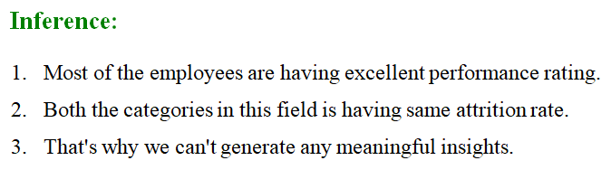

Slide 15
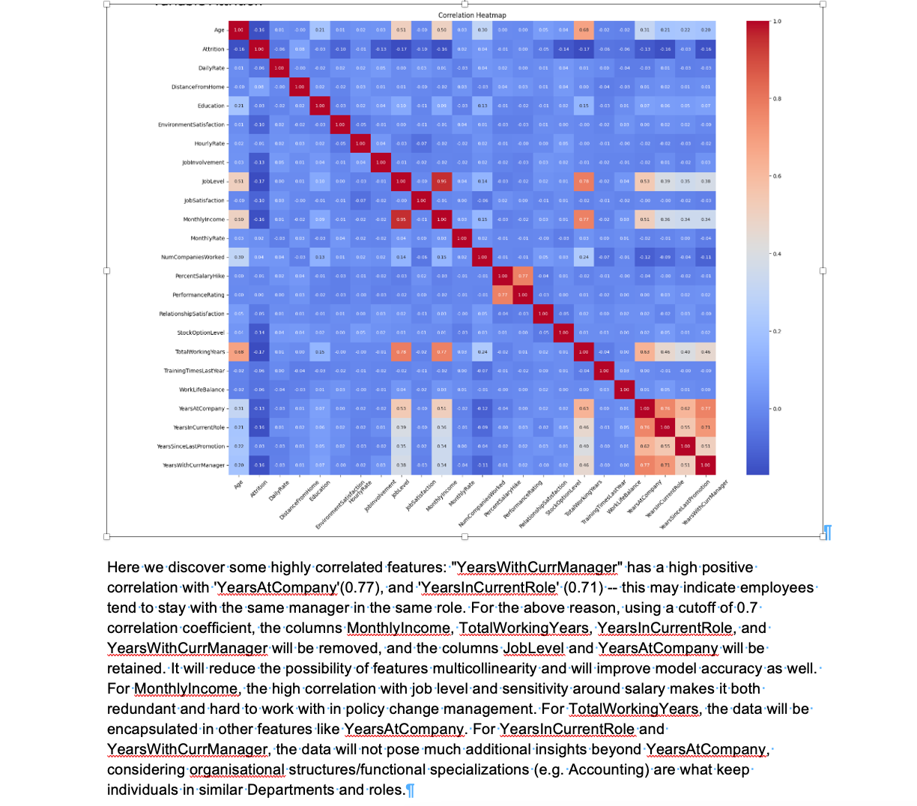

Slide 16
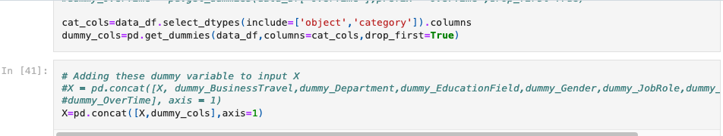
Label encoding

Slide 17
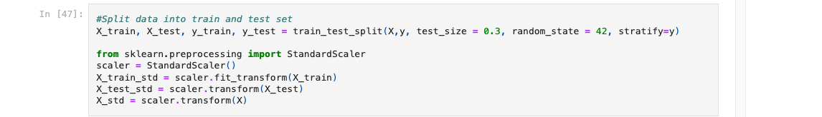
TRAIN AND TEST DATASET

Slide 18
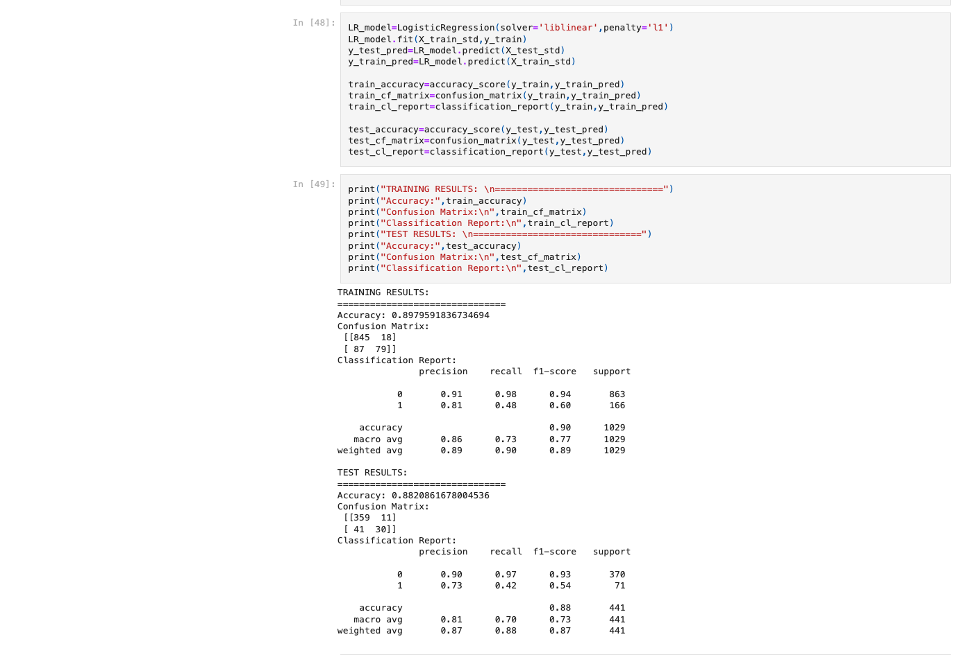
LOGISTIC REGRESSION

Slide 19
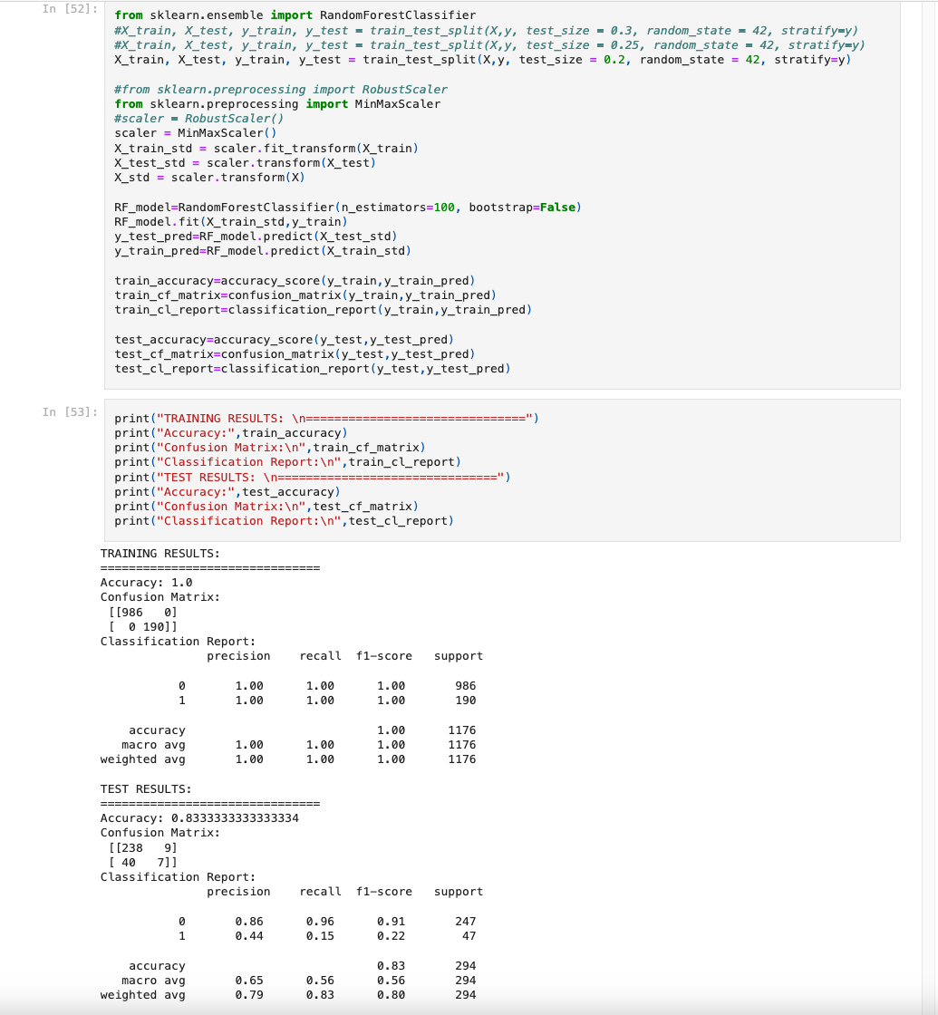
RANDOM FOREST CLASSIFIER

Slide 20
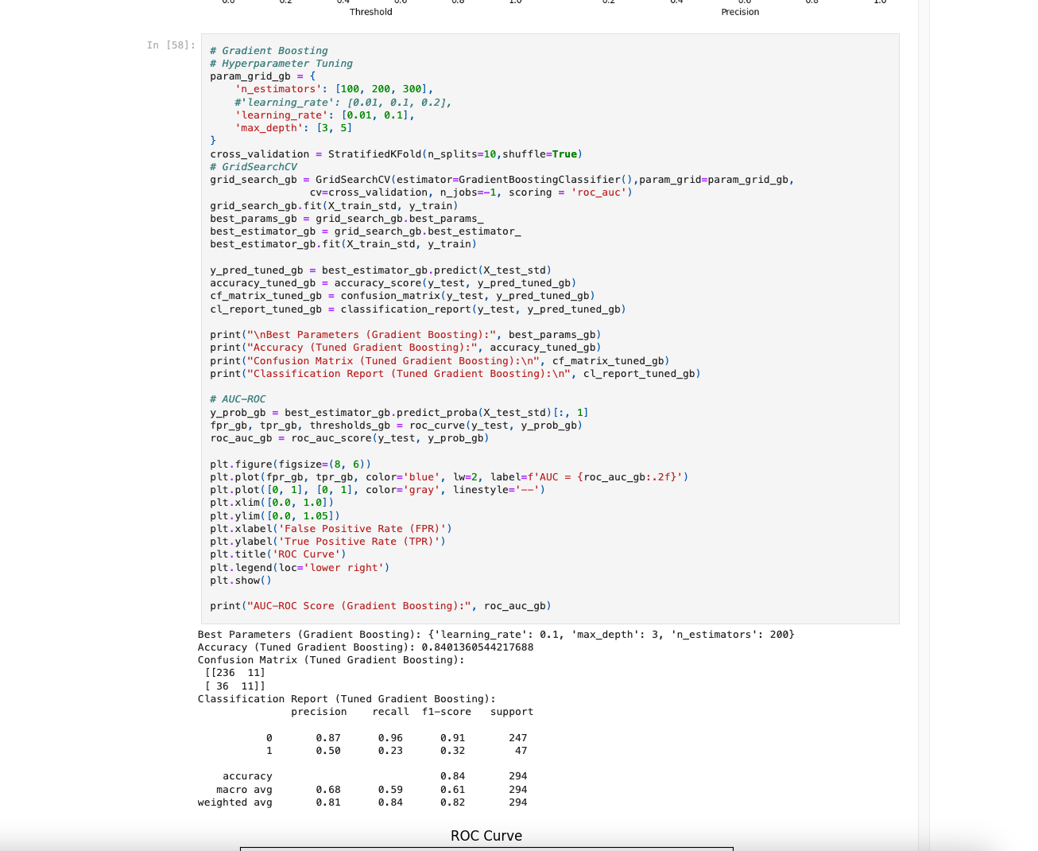
GRADIENT BOOSTING

Slide 21
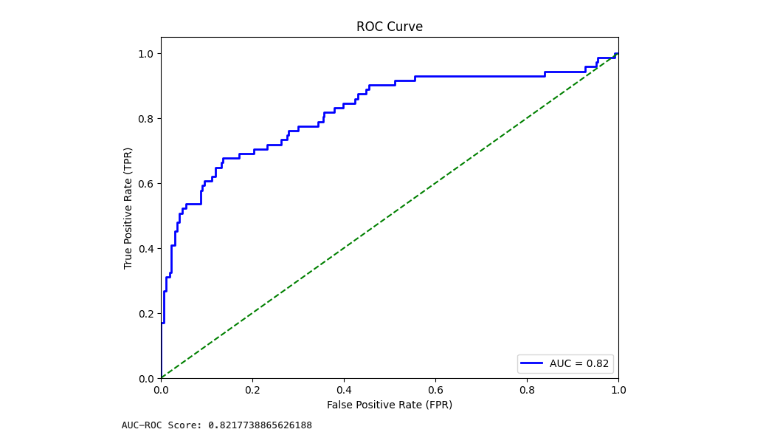
ROC CURVE
(Logistic Regression)

Slide 22
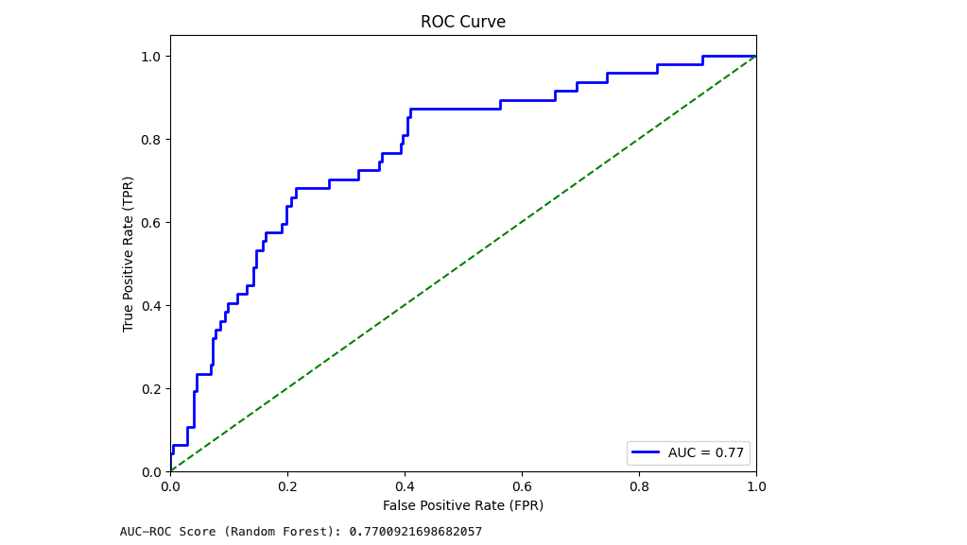
ROC CURVE
(Random Forest Classifier)

Slide 23
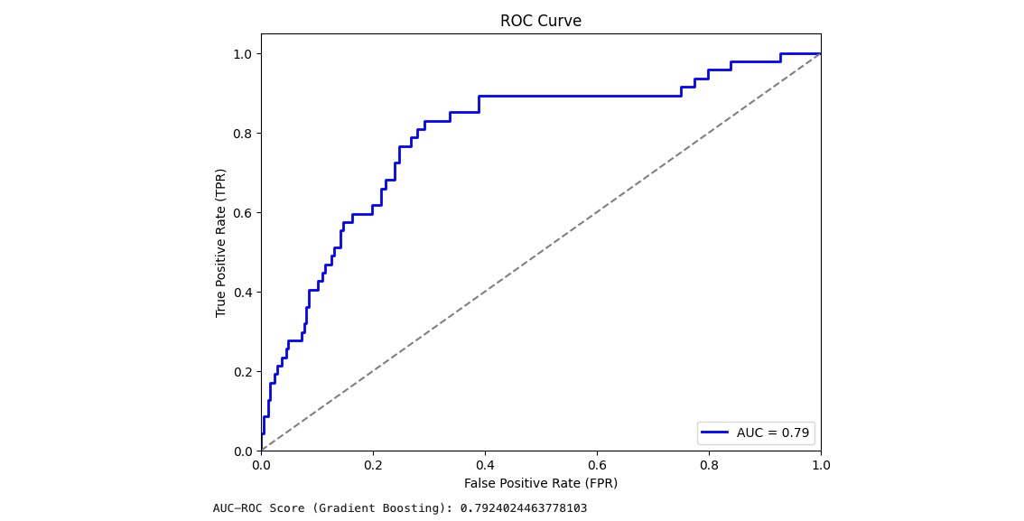
ROC CURVE
(Gradient Boosting)

Slide 24
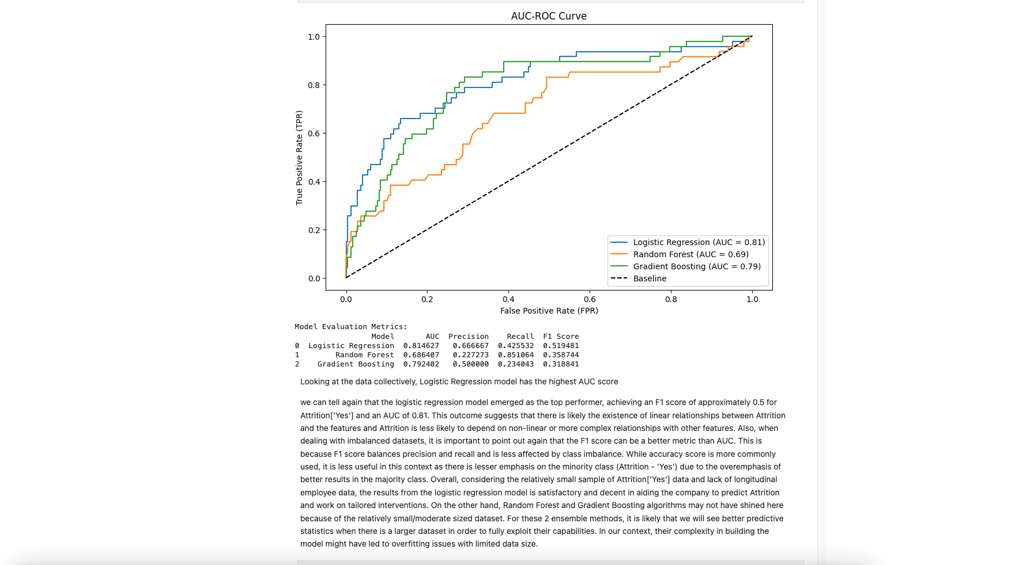
Model Comparison

Slide 25
Conclusion
In conclusion, we embarked on a comprehensive analysis of the IBM HR Analytics Attrition Dataset, from data loading to model evaluation. By implementing and evaluating various machine learning algorithms, we gained insights into which models are effective for predicting employee attrition. The results and visualizations generated throughout the process provide valuable information for decision-makers and HR professionals seeking to understand and mitigate employee attrition within the organization. This project showcases the power of data analysis and machine learning in addressing real-world business challenges.

